Slide 1
blood bank management system
Presented by -
Group 03 (Thanos)
Nazmus Sakib Akash
Md. Aosaful Alam
Shahan Jamil Bhuiyan
Ashraful Jannat

Slide 2

blood bank management system
Four phases that our system will go through-
Planning
Analysis
Design
Implementation

Slide 3
blood bank management system-why?
Huge demand for blood due to increasing accidents and population boom.
4.8 million people in Bangladesh carrying Thalassemia according to WHO
Existing system being analog and inefficient in emergency situations.
Creating a community consisting of blood banks, common people and donors.

Slide 4
blood bank management system
FEASIBILITY ANALYSIS-
How successfully a project can be completed, accounting for factors that affect it such as -
Economic
Technical
Organizational
Blood Management System's feasibility analysis shows why this is a project worth investing in.

Slide 5
blood bank management system
Technical feasibility-
Blood Donation System is possible for implementation because -
Based on a database system that can be handled with ease.
Huge labor force not needed to implement the project.
Developers are familiar with the technology used for implementation.

Slide 6
blood bank management system
Economic Feasibility-
Blood donation system should be implemented because it will break even. The reasons are -
Minimal costing in the production time.
Ad revenue to break even the costs.
Revenue from sponsors which are estimated around 8 lacs per year.

Slide 7
blood bank management system
Return of investment-
ROI = 195220 / 23804780 = 0.82%
Break even point-
BEP = 2 + (127000-68220) / 127000 = 2.46 YEARS

Slide 8
blood bank management system
organizational Feasibility-
Blood donation system will be organizationally feasible because -
Extremely user friendly.
Easily adaptable and reviewable.
It would be incorporated in organizations due to the increasing health codes.

Slide 9
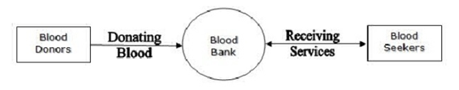
blood bank management system
How the system will work-
Admin panel
Donors
Donors Registration
Acceptors
Life Saving Contacts

Slide 10
blood bank management system
Requirements gathering-
How did we gather?
Taking interviews
Survey
Report
Joint Application Development(JAD)

Slide 11
blood bank management system
Requirements-
Non-Functional requirements-
Security
Concurrency & Capacity
Reliability
Maintainability
Usability
Documentation
Functional requirements-
Admin login
Password change
Donor registration
User & hospital registration
Connection between Blood-banks

Slide 12
blood bank management system
Requirements-
Hardware requirements-
Intel core-i7 7th generation
8gb DDR4 RAM
1TB hard drive
Internet
External hard drive
Software requirements-
Windows 7 of after
HTML
CSS
JavaScript
PHP
SQL

Slide 13
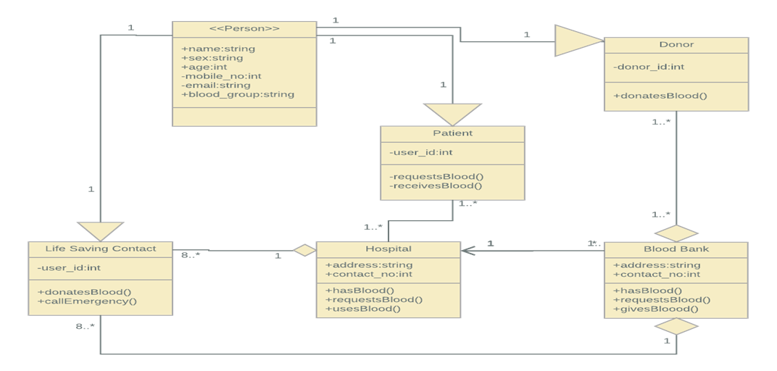
blood bank management system
Class diagram-

Slide 14
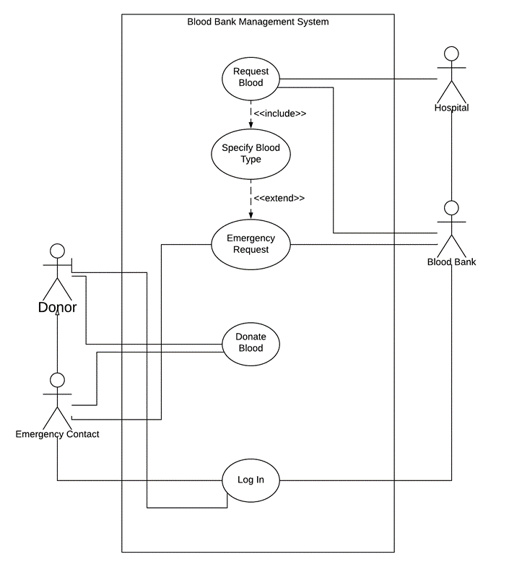
blood bank management system
Use-case diagram-

Slide 15
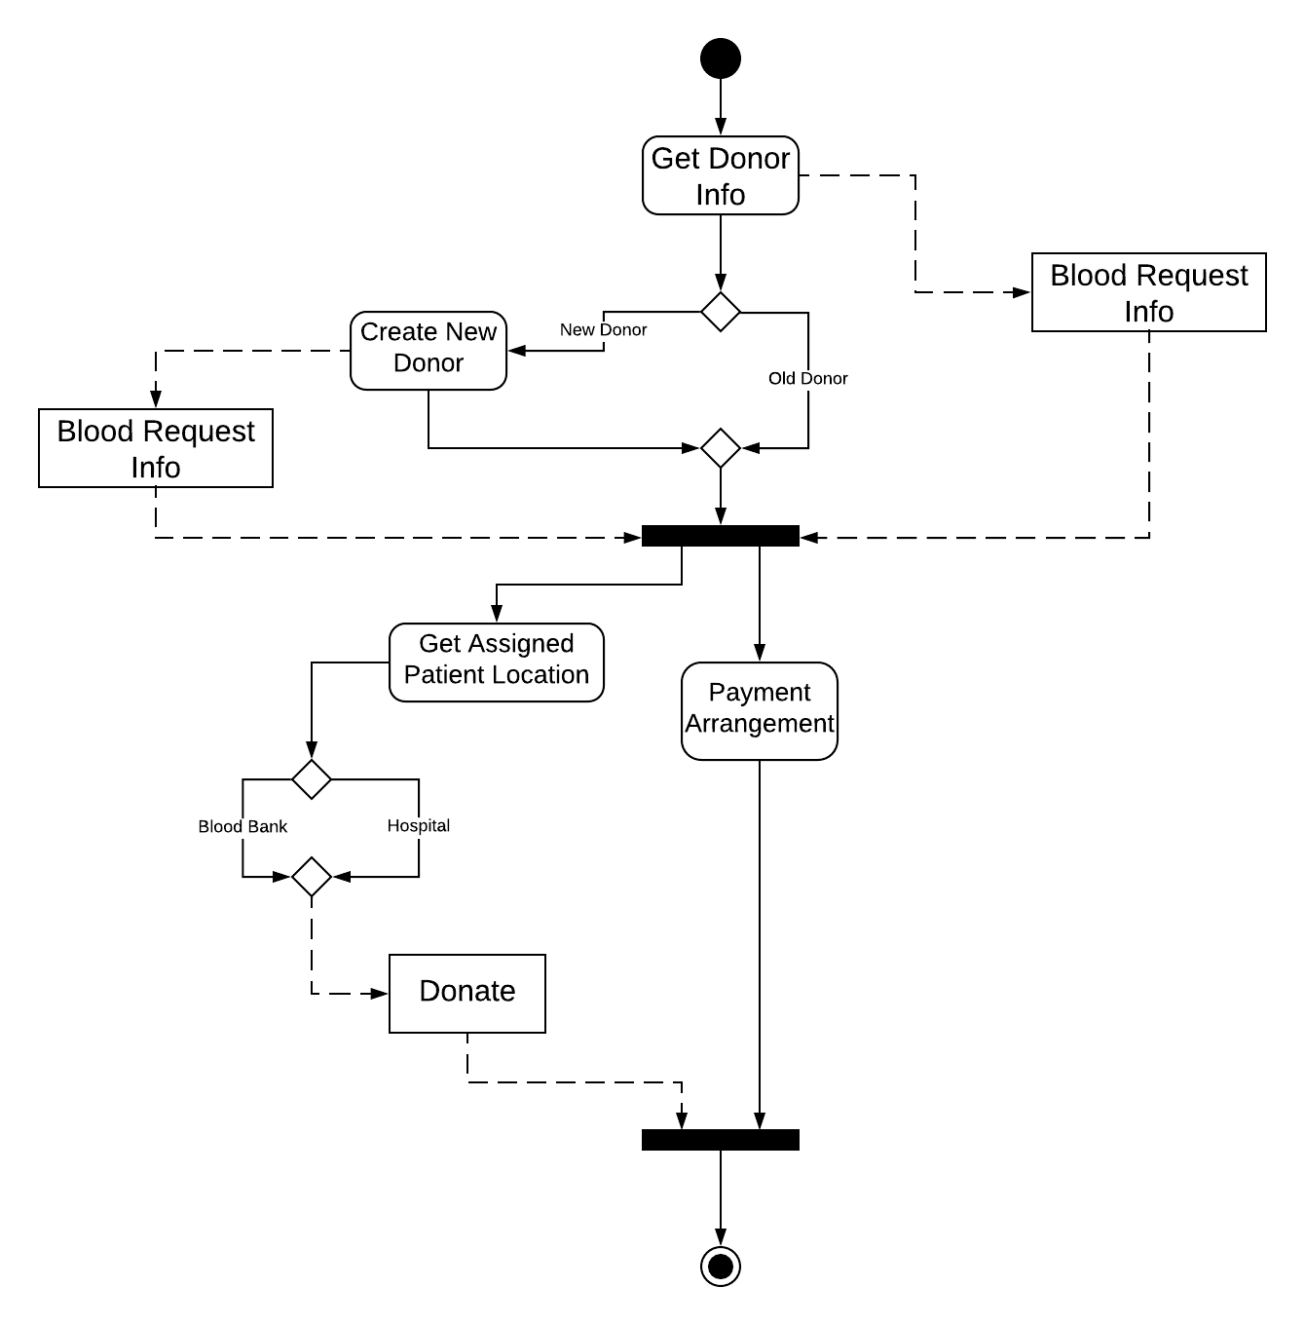
blood bank management system
activity diagram-

Slide 16
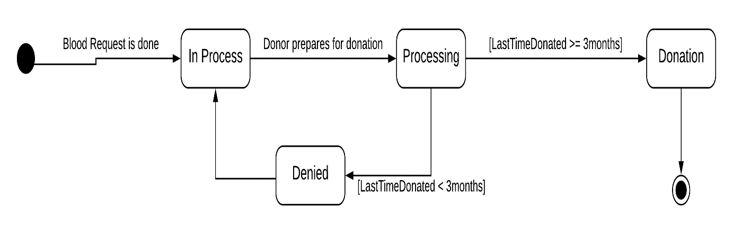
blood bank management system
Behavioral state machine diagram-

Slide 17
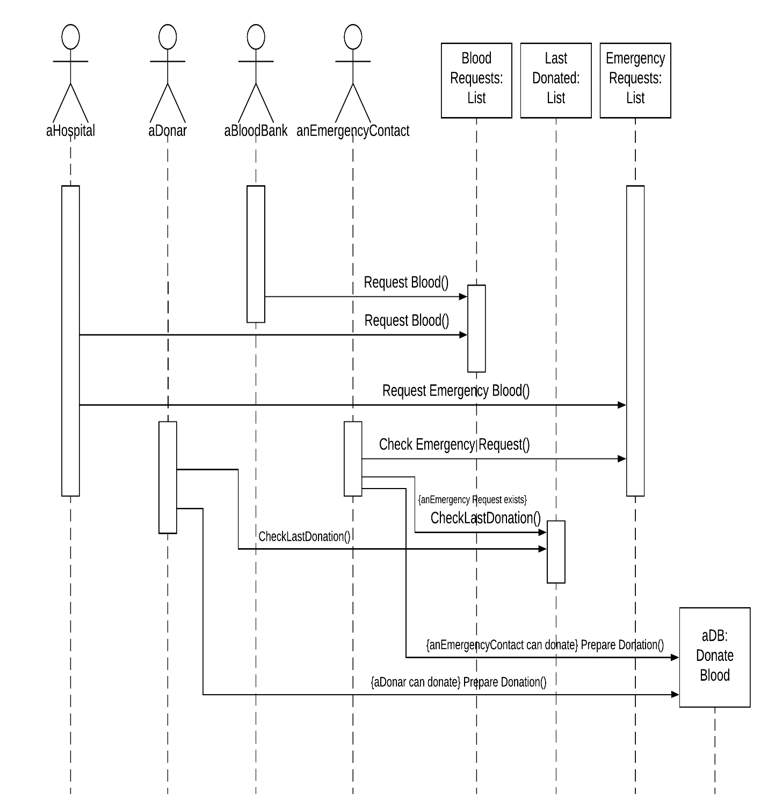
blood bank management system
sequence diagram-

Slide 18
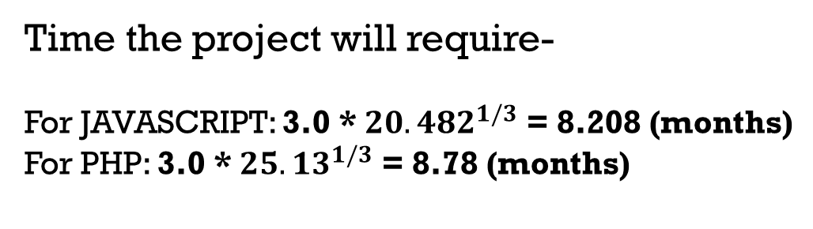
blood bank management system
Function point-
Estimated system size-
TUFP: 665
Total Processing complexity: 20
Total Adjusted Function Points (TAFP): 565.25
Effort that will be required-
For JAVASCRIPT: 1.4 * 14.63 = 20.482 p/m
For PHP: 1.4 * 17.95= 25.13 p/m
Time the project will require-
For JAVASCRIPT: 3.0 *${20.482}^{1/3}$ = 8.208 (months)
For PHP: 3.0 *${25.13}^{1/3}$ = 8.78 (months)

Slide 19
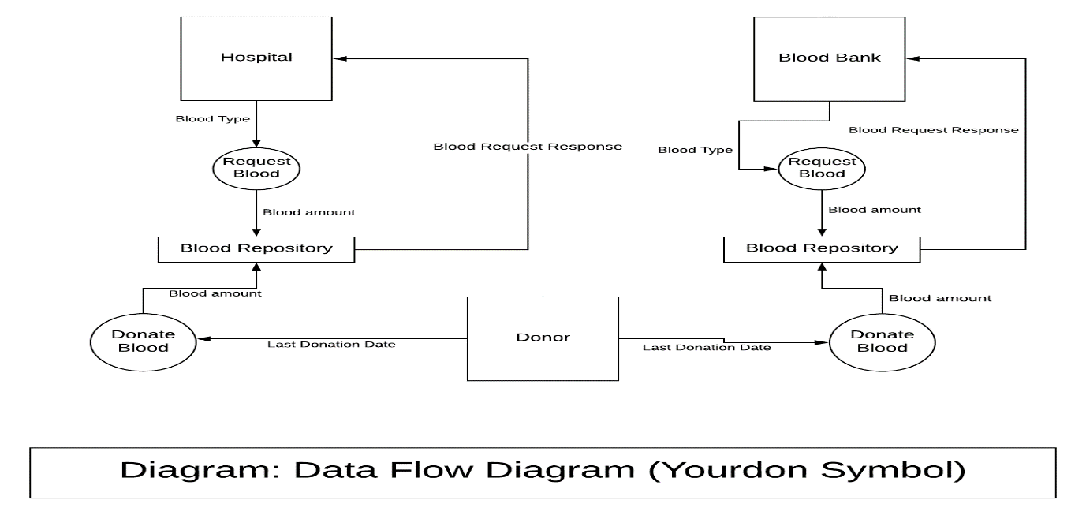
blood bank management system
Data flow diagram-

Slide 20
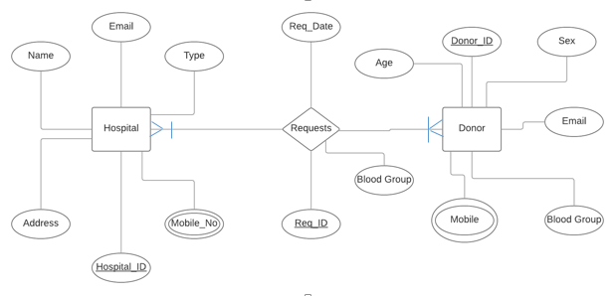
blood bank management system
Entity relationship diagram-

Slide 21
blood bank management system
Blood Bank Management System is possible for implementation because -
Based on a database system that can be handled with ease.
Huge labor force not needed to implement the project.
Developers are familiar with the technology used for implementation.

Slide 22
blood bank management system
Future plan-
Save more time, money and hassles
Spread the system in whole country
Review system for the users
Upgradation of the system

Slide 23
Questions???

